Slide 1

SWD 392 - Software Architecture and Design

Slide 2
SWD392:
Software Subsystem Architectural Design

Slide 3
Introduction
In this chapter, we will provide an approach for decomposing the system into subsystems and developing the overall software architecture of the system.

Slide 4
Table of contents
01
Issues in Software Architectural Design
02
Integrated Communication Diagrams
Separation of Concerns in Subsystem Design
03
04
Subsystem Structuring Criteria
Decisions about Message Communication between Subsystems
05

Slide 5
01
ISSUES IN SOFTWARE ARCHITECTURAL DESIGN

Slide 6
Design Goal Is Also The Issue
Design Goal: “for each subsystem to perform a major function that is relatively independent of the functionality provided by other subsystems.”
A subsystem can be structured further into smaller subsystems.
After the interface between subsystems has been defined, subsystem design can proceed independently.
Issue: How to realize this goal???

Slide 7
A guidance
A good place to start is with the use cases. Because objects that participate in the same use case are candidates to be grouped into the same subsystem.
Object that participate in multiple use cases is usually allocated where it is most highly coupled.
But…what if there are also situations in which objects that participate in the same use case need to be assigned to different subsystems?
=> This will be explore in later chapters.

Slide 8
02
INTEGRATED COMMUNICATION DIAGRAMS

Slide 9
Why do we need it?
Why? To transition from analysis to design and to determine the subsystems, it is necessary to synthesize an initial software design from the analysis carried out so far.
How? By integrating the use case–based interaction diagrams developed as part of the dynamic model.
What? In the analysis model, at least one communication diagram is developed for each use case. The integrated communication diagram is a synthesis of all the communication diagrams developed to support the use cases.

Slide 10
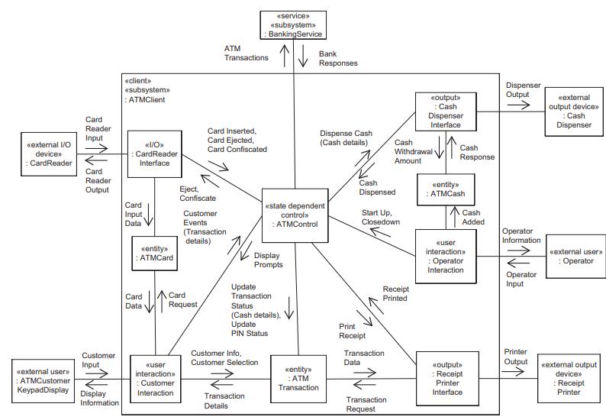
An example…
Integrated Communication Diagram for previous chapter example

Slide 11
03
SEPARATION OF CONCERNS IN SUBSYSTEM DESIGN

Slide 12
Design Goal
Let’s explore some methods to realize our goal
The goal is to make subsystems more self-contained, so that different concerns are addressed by different subsystems.

Slide 13
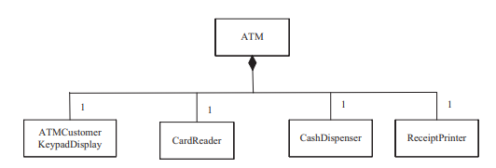
Composite Object
A composite object is typically composed of a group of related objects that work together in a coordinated fashion
Objects that are part of the same composite object should be in the same subsystem and separate from objects that are not part of the same composite object.
The composite object (the whole) and its constituent objects (the parts) are created together, live together, and die together.
ATM is the composite object, others are constituent objects.

Slide 14
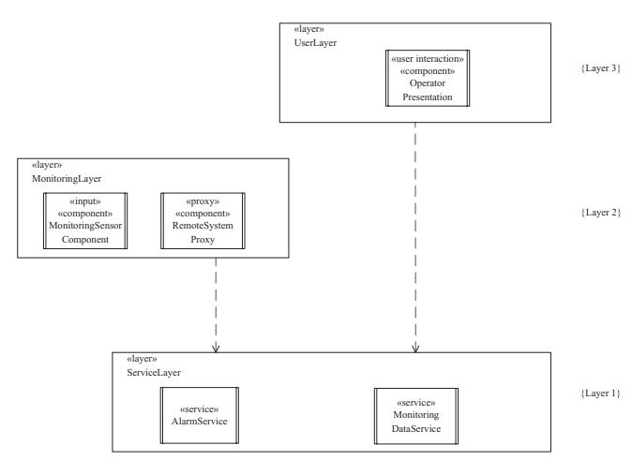
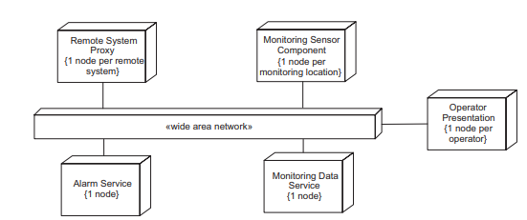
Geographical Location
If two objects could potentially be physically separated in different geographical locations, they should be in different subsystems.
In the example, the service layer is divided because the 2 services don’t related by any mean.

Slide 15
Clients and Services
Obvious reason, clients and services/servers are usually at different locations.

Slide 16
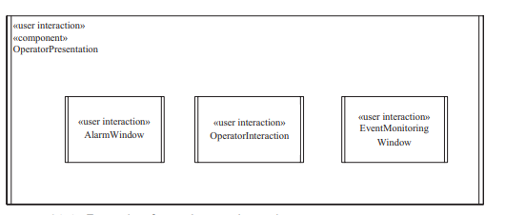
User Interaction
Obvious reason, interaction objects (GUI elements) related to each other should be grouped together.

Slide 17
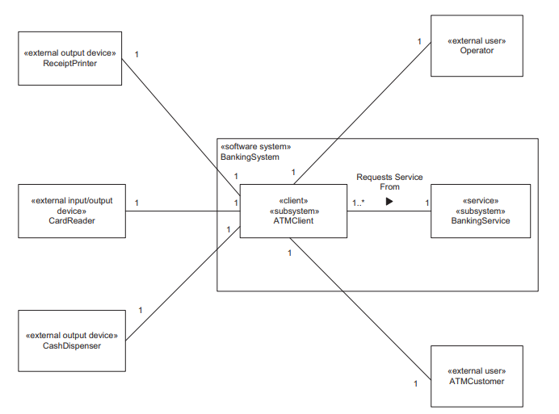
Interface to External Objects
An external real-world object should interface to only one subsystem.
In this example, real-world object like Receipt Printer, Operator,... only interface ATMClient subsystem.

Slide 18
Scope of Control
A control object and all the entity and I/O objects it directly controls should all be part of one subsystem and not split among subsystems.

Slide 19
04
SUBSYSTEM STRUCTURING CRITERIA

Slide 20
SUBSYSTEM STRUCTURING CRITERIA
The design considerations described in the previous section can be formalized as subsystem structuring criteria, which help ensure that subsystems are designed effectively.
Subsystems are generally depicted with the stereotype «subsystem». For certain software architectures consisting of distributed component-based subsystems, the stereotype «component» is used for such a subsystem, and in service-oriented architecture consisting of service subsystems, the stereotype «service» is used for a service subsystem.

Slide 21
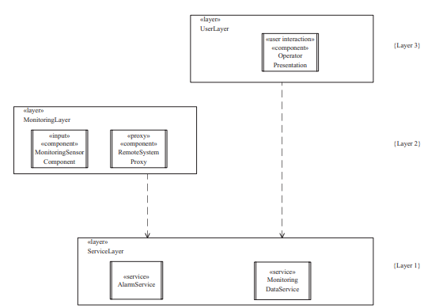
Client Subsystem
A client subsystem is a requester of one or more services.
Client subsystems include user interaction subsystems, control subsystems, and I/O subsystems. (will be detailed later)
A client subsystem may combines more than one role.
In this example, The Monitoring Sensor Component, Remote System Proxy, and Operator Presentation components are clients of Alarm Service and Monitoring Data Service

Slide 22
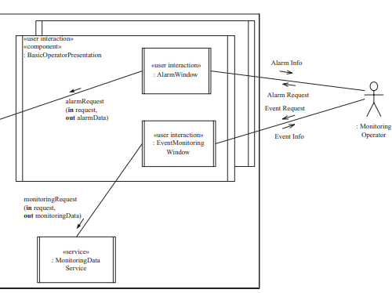
User Interaction Subsystem
A user interaction subsystem provides the user interface and performs the role of a client in a client/server system, providing user access to services. There may be more than one user interaction subsystem – one for each type of user.
A user interaction subsystem is usually a composite object that is composed of several simpler user interaction objects.
May contain entity objects for local storage and caching, and control objects for overall sequencing of user input and output.
In this example, the Operator actor interacts with the system through two Windows of UI Subsystem

Slide 23
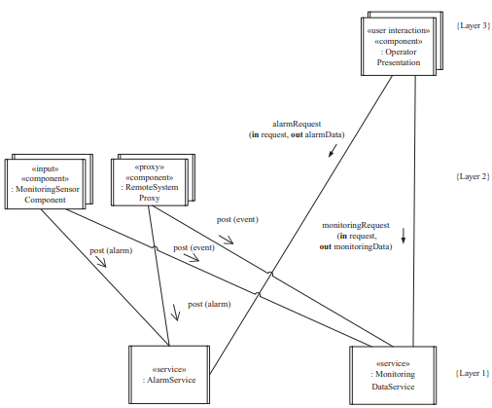
Service Subsystem
A service subsystem provides a service for client subsystems. It responds to requests from client subsystems, although it does not initiate any requests.
Include entity objects, coordinator objects that service client requests and determine what object should be assigned to handle them, and business logic objects that encapsulate application logic.
Usually associated with a set of related data repositories to access database or I/O devices.
In this example, Alarm Service and Monitoring Data Service belong to Service Subsystem

Slide 24
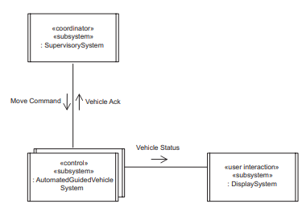
Control Subsystem
A control subsystem controls a given part of the system. The subsystem receives its inputs from the external environment and generates outputs to the external environment.
A control subsystem is often state-dependent, in which case it includes at least one state-dependent control object.
In this example, AutomatedGuidedVehicleSystem will control the physical motor component after receiving signal from SupervisorySystem.

Slide 25
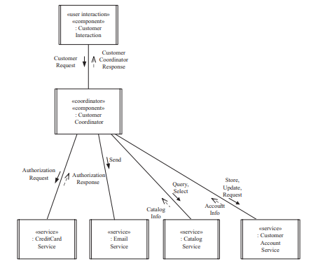
Coordinator Subsystem
Coordinator subsystems coordinate the execution of other subsystems, such as control subsystems or service subsystems.
This is a mandatory subsystem when to coordinating tasks are relatively complex such as deciding workflow for control subsystems or coordinating services in service-oriented architectures.
In this example, CustomerCoordinator has to communicate with multiple services to serve different kinds of request from Customer

Slide 26
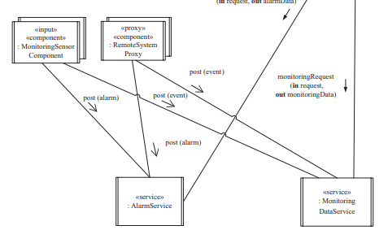
Input/Output Subsystem
An input, output, or input/output subsystem is a subsystem that performs input and/or output operations on behalf of other subsystems.
Can be designed to be relatively autonomous.
In this example, the MonitoringSensorComponent is an input subsystem which receiving data from multiple sensors.

Slide 27
05
DECISIONS ABOUT MESSAGE COMMUNICATION BETWEEN SUBSYSTEMS

Slide 28
Making Decision…
In the transition from the analysis model to the design model, one of the most important decisions relates to what type of message communication is needed between the subsystems.
A second related decision is to determine more precisely the name and parameters of each message.
In design modeling, a decision has to be made about the precise semantics of message communication, such as whether message communication will be synchronous or asynchronous.
The aforementioned decisions concerning asynchronous and synchronous communication are formalized into architectural communication patterns.

Slide 29
Thanks!
Does anyone have any questions?
CREDITS: This presentation template was created by Slidesgo, including icons by Flaticon, infographics & images by Freepik
Please keep this slide for attribution

